Slide 1
Model Development
CS4981 ML Production Systems
RJ Nowling

Slide 2
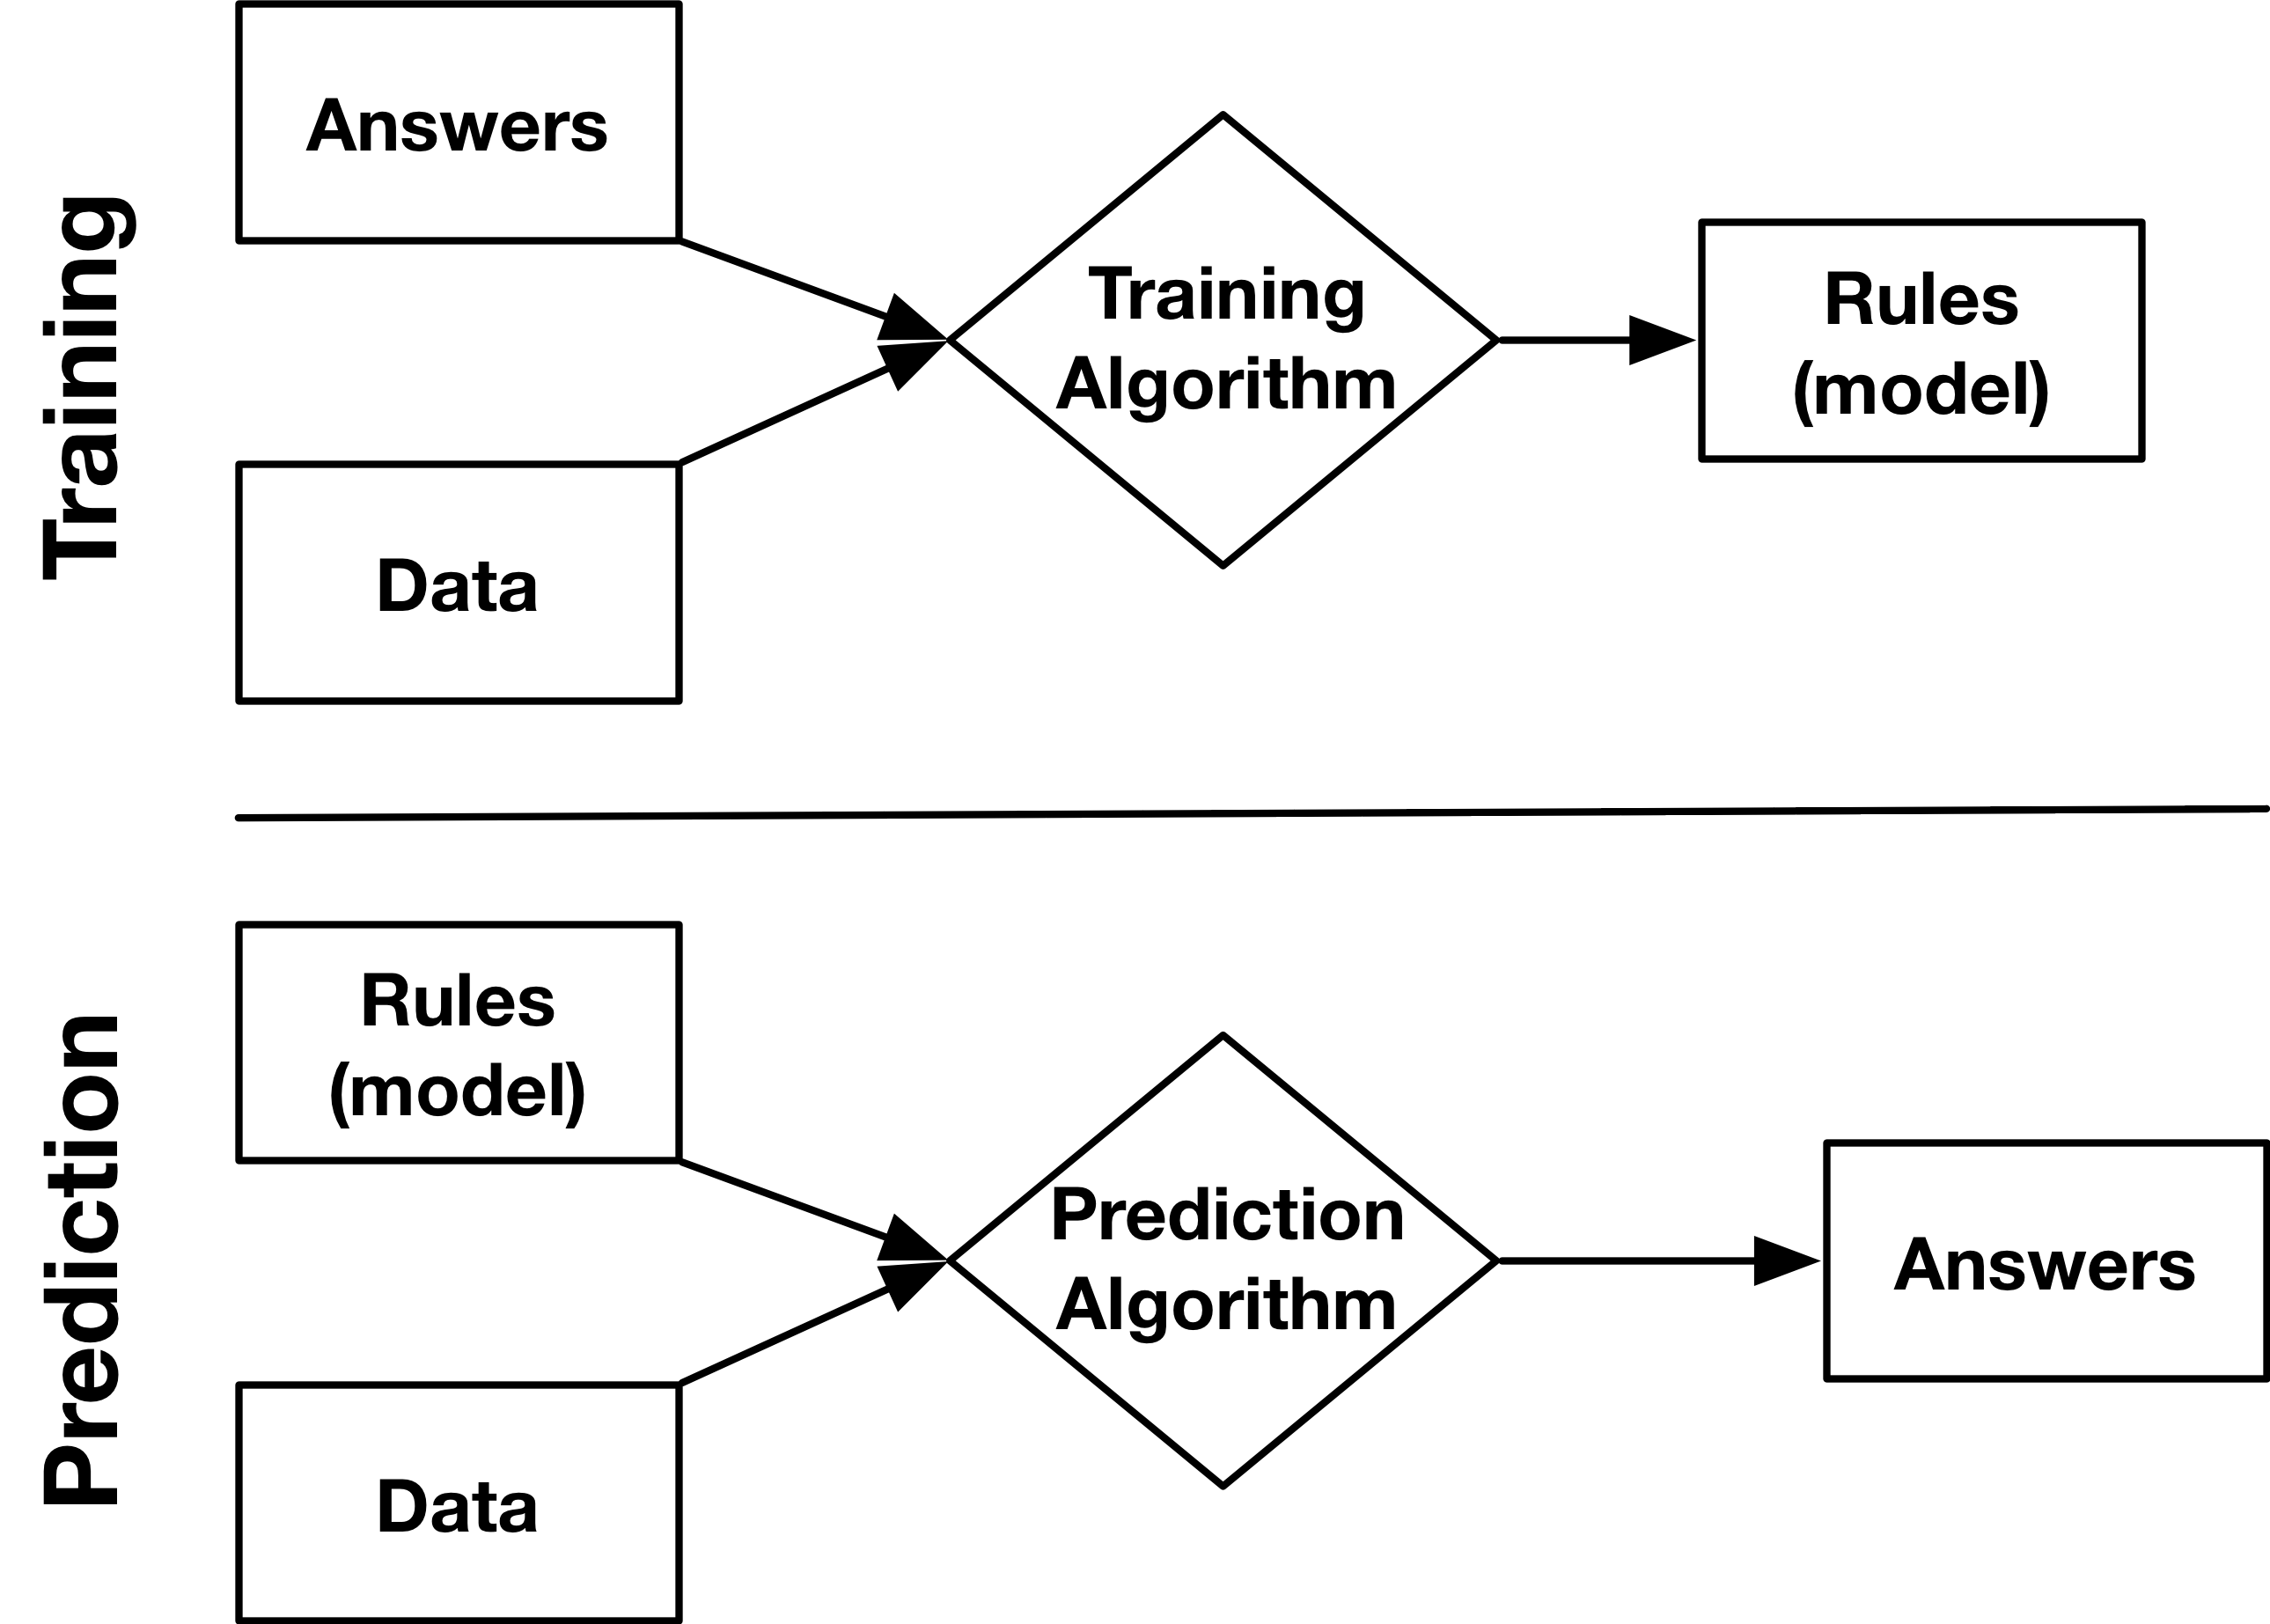
Supervised Machine Learning

Slide 3
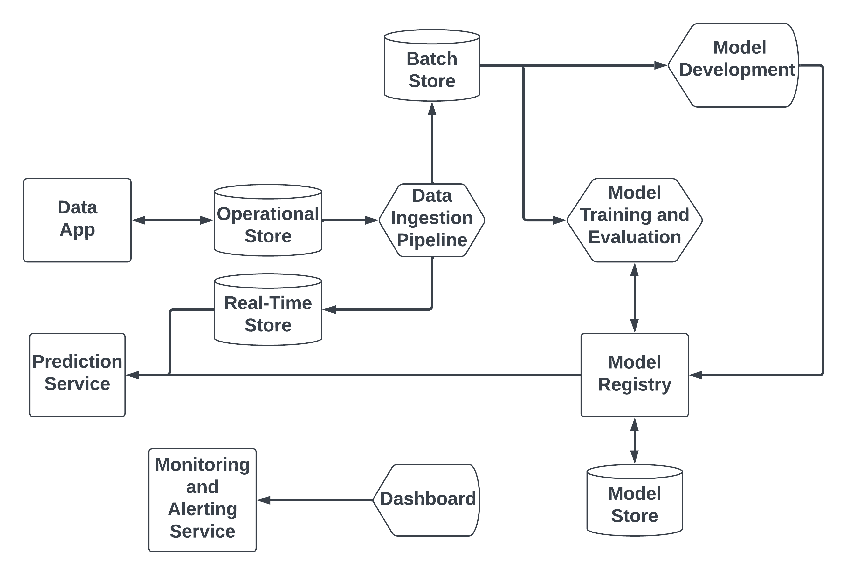
General Architecture

Slide 4
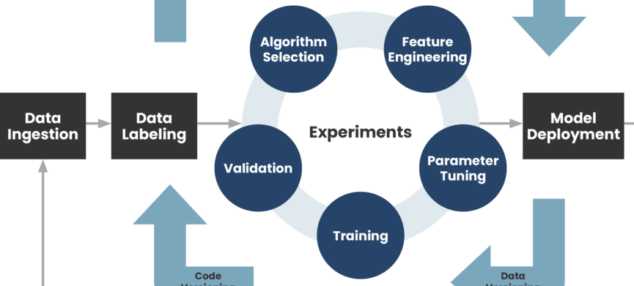
Model Development
Source: https://www.phdata.io/blog/mlops-vs-devops-whats-the-difference/

Slide 5
Experimental Setup
In most real-world use cases, we want to:
Train a model on data we have
to make predictions on data we haven't seen yet
Examples:
Predict what ads a user will click on given their past history
Determine if a scan indicates cancer or not
Determine if an email is spam or not

Slide 6
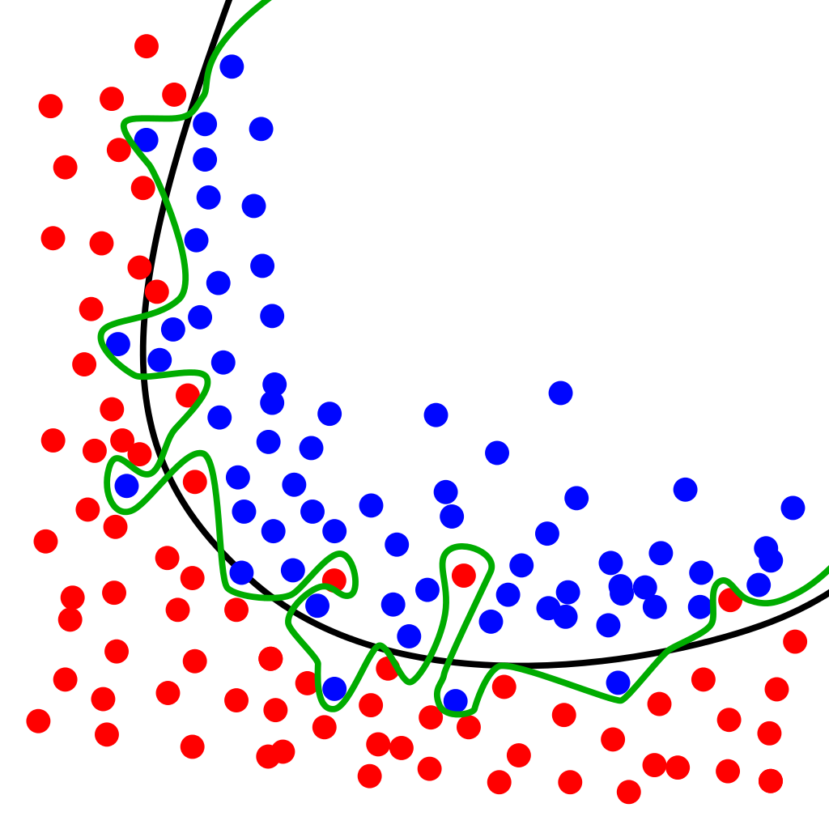
Overfitting
A model can "memorize" its training data
and fail to find decision boundaries that work well on any other data
We say the the model is "overfit" and "fail to generalize"
We need ways to evaluate models to detect and avoid overfitting

Slide 7
Experimental Setup
We want our experiments to tell us how a model will perform when applied to unseen data
We design our experiment to match the real-world use case
We divide data (records) into:
Training set – used for training the model
Validation set – used for optimizing model hyper-parameters (most commonly used with deep learning)
Testing set – used for evaluating the model's predictions
Since none of the testing data is used in training, it becomes an accurate way to evaluate a model's performance on unseen data

Slide 8
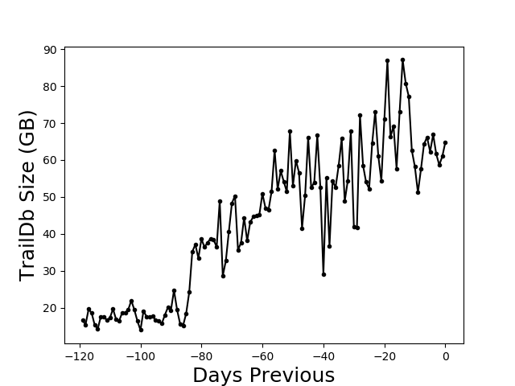
Train-Test Split for Time
Partition by Time
Used for data that depends on time (e.g., weather data)
Procedure
Choose a cutoff time: either a single point in time OR for each record individually
Training set: all records before the cutoff
Testing set: all records after the cutoff

Slide 9
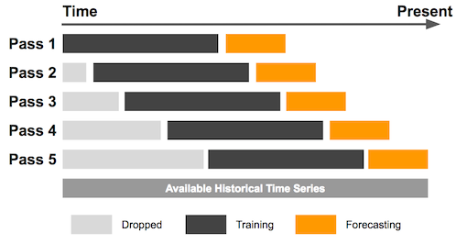
Sliding / Tumbling Windows

Slide 10
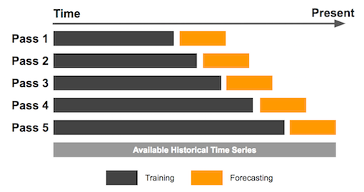
Expanding Window

Slide 11
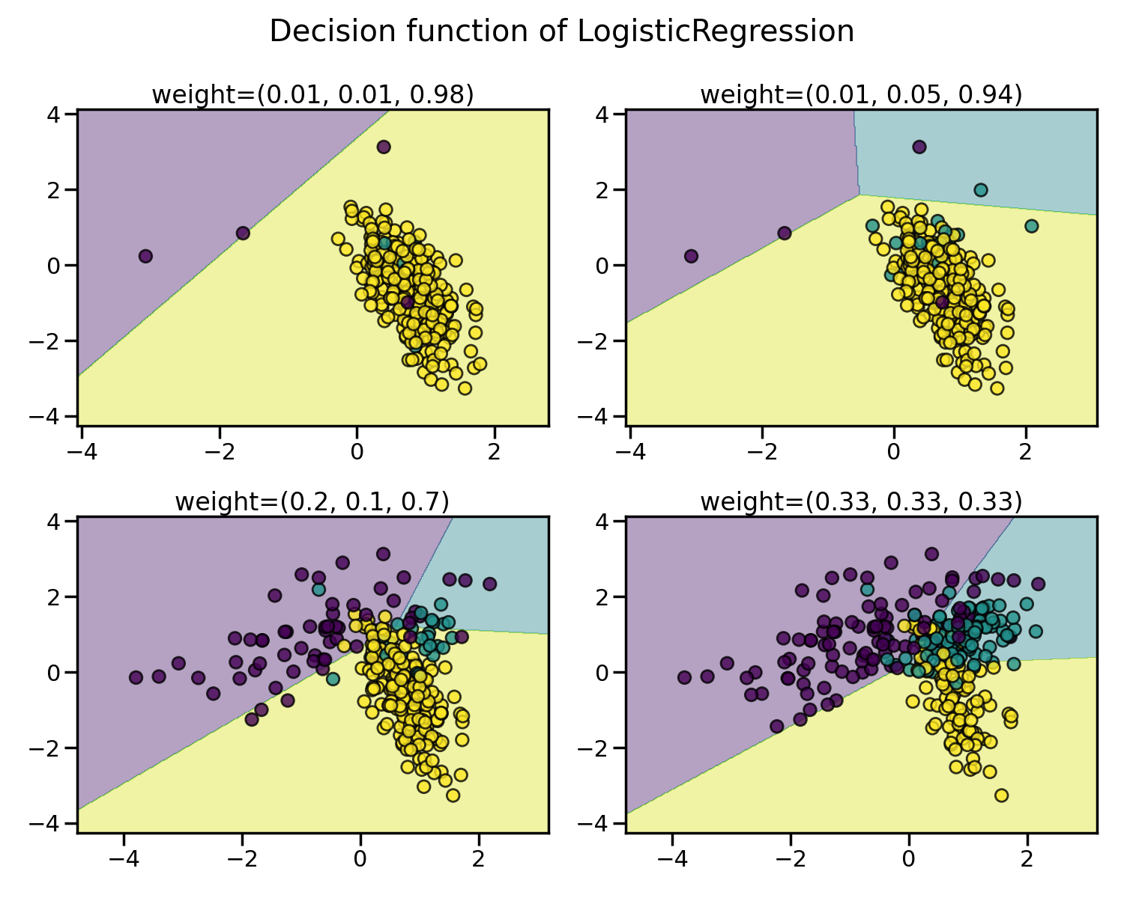
Imbalanced Data
https://imbalanced-learn.org/stable/introduction.html#problem-statement-regarding-imbalanced-data-sets

Slide 12
Handling Class Imbalance
Under-sampling
Over-sampling
Synthetic augmentation
Training, testing, or both?
Imbalanced learn: https://imbalanced-learn.org/stable/index.html

Slide 13
Model Development
Source: https://www.phdata.io/blog/mlops-vs-devops-whats-the-difference/

Slide 14
Model Selection
Regression
Classification
Linear Regression
Random Forests
Support Vector Machines
Neural Networks
Logistical Regression
Random Forests
Support Vector Machines
Neural Networks

Slide 15
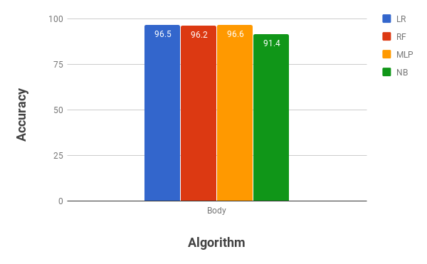

Slide 16
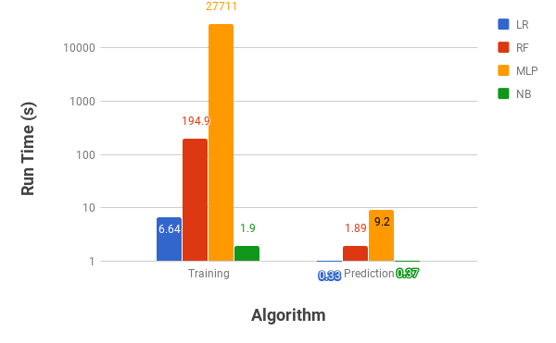

Slide 17
Model Development
Source: https://www.phdata.io/blog/mlops-vs-devops-whats-the-difference/

Slide 18
Feature Engineering
Machine learning algorithms expect a matrix of variables
Variables called features
All features must be floating-point numbers
Feature engineering is the process of creating features from our data
Numerical representations of variables
Create new features from existing variables

Slide 19
Numerical Data
Examples: a person's height, square footage of a building, petal width
Each of these can be represented as a single numerical variable
Very little feature engineering to do

Slide 20
Boolean Data
Booleans can be presented as floating points numbers with values of 0 and 1
Boolean columns may need to be converted to floats: df["my_column"] = df["my_column"].astype(np.float32)

Slide 21
Categorical Variables
Categorical variables need to be represented numerically
Common mis-practice is to represent categories as a single numerical variable:
1 – Red
2 – Green
3 – Blue
The problem is that it implies an ordering which is not appropriate
distance(Blue, Red) = 2
distance(Blue, Green) = 1

Slide 22
Categorical Variables
Is it better to use one-hot encoding:
A separate numerical variable is created for each category
1 indicates which category applies
Only one category can be present in a single record so only one of the variables has a 1
distance(Blue, Red) = 1
distance(Blue, Green) = 1
Red | Green | Blue
1 | 0 | 0
1 | 0 | 0
0 | 0 | 1

Slide 23
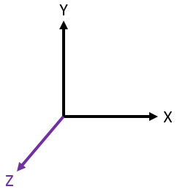
One-Hot Encoding

Slide 24
Categorical Variables
Pandas has utility functions that can create dummy variables for categorical variables: df["beds_cats"] = df["beds"].astype("category") dummies = pd.get_dummies(df["beds_cats"], prefix="beds_cats") df = df.merge(dummies, left_index=True, right_index=True)

Slide 25
Encoding Integers as Categories
It can be helpful to encode certain integers as categories
Number of bedrooms
Number of bathrooms
Day of the week
Why? Let's assume the average value of a house
Increases by $20k when you got from 2 bedrooms to 3
Increases by $40k when you go from 3 bedrooms to 4
This is a non-linear relationship – it may be due to other factors like larger houses are in wealthier areas
In linear models, we approximate non-linear relationships by treating such variables as categorical

Slide 26
Dates and Times
Pandas can identify date and time strings in certain specific formats but often times real data has slight variations
The Python datetime.datetime.strptime() function can be used to parse a date time string and return a DateTime object.
You probably already did this during the data cleaning steps.

Slide 27
Dates and Times
We can engineer a few features from Date or DateTime objects
Convert to Unix epoch to get a single numerical value representing progression of time df["timestamp"] = df["datetime"].map(lambda dt: dt.timestamp())

Slide 28
Dates and Times
Often, we not interested in absolute time but periods of time
Hour of the day
Day of the week
Month of the year
Season (summer, fall, winter, spring)
Machine learning models cannot infer periodicity, so we have to manually engineer features

Slide 29
Dates and Times
Hours: df["hour_of_day"] = df["datetime"].map(lambda dt: t.hour)
Day of the week: day_of_week = df["datetime"].map(lambda dt: dt.weekday())

Slide 30
Dates and Times
Month of the Year: df["month"] = df["datetime"].map(lambda dt: t.month)

Slide 31
Dates and Times
Hour of the day may be too granular. You want periods of the day:
Early morning – midnight to 8 am
Morning – 8 am to noon
Afternoon – noon to 5 pm
Evening – 5 pm to midnight

Slide 32
Dates and Times
The day of the week will be returned as an integer. It can be useful to make it categorical: day_of_week = day_of_week.astype("category") dummies = pd.get_dummies(day_of_week prefix="day_") df = df.merge(dummies, left_index=True, right_index=True)

Slide 33
Dates and Times
def to_periods(hour): if hour < 8: return 0 elif hour < 12: return 1 # 5pm, 24 hour time elif hour < 17: return 2 else: return 3 df["periods"] = df["datetime"].map(lambda dt: to_periods(dt.hour))
And then make it categorical.

Slide 34
Text Data
Dear Class, I've uploaded the new homework to D2L. It's due on Monday. I'm looking forward to seeing your solutions! RJ
?
[0, 1, 0, 0, 0, 1, 1, 0, 0]

Slide 35
Bag of Words Model
The simplest approach is a bag of words model
We keep track of how many times each word appears in each document
Each word count is stored as a separate column
Some variations:
Pre-process vocabulary to perform "stemming"
Binary (absence / presence) instead of counts
Weight the words based on document frequency (e.g., rare words get high weights, common words get lower weights)

Slide 36
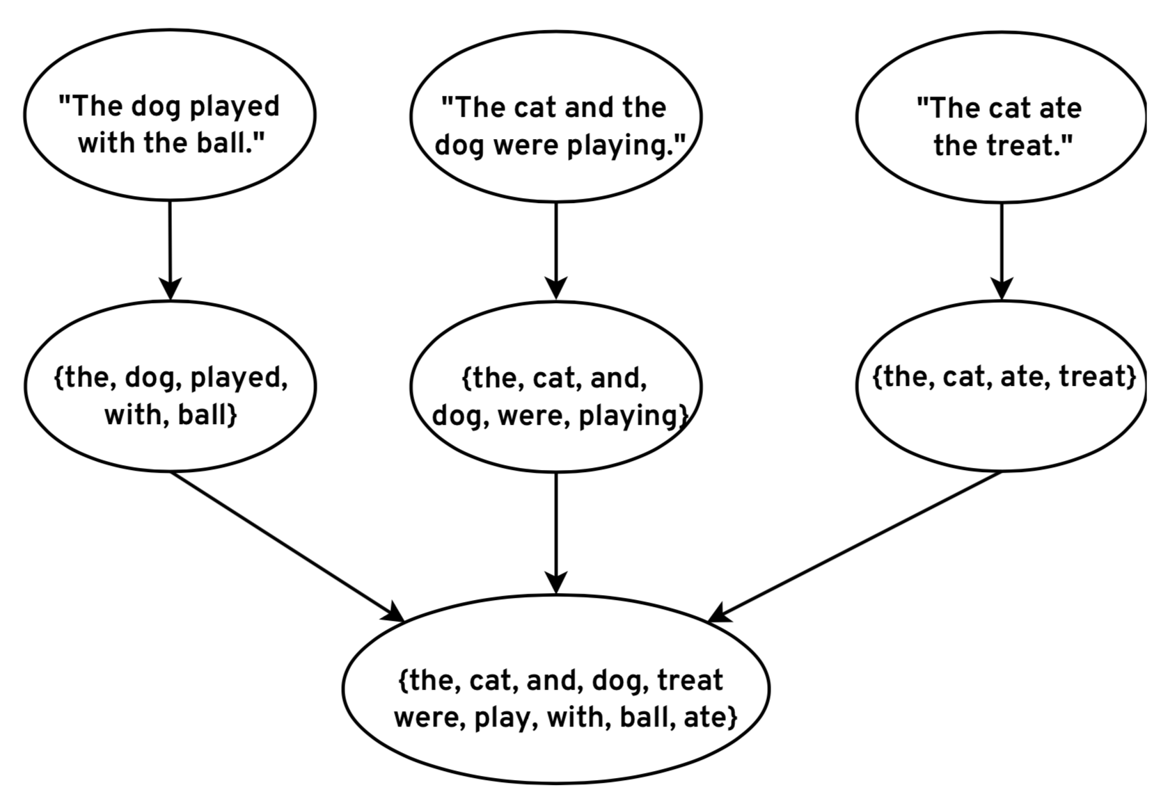
Extract Vocabulary

Slide 37
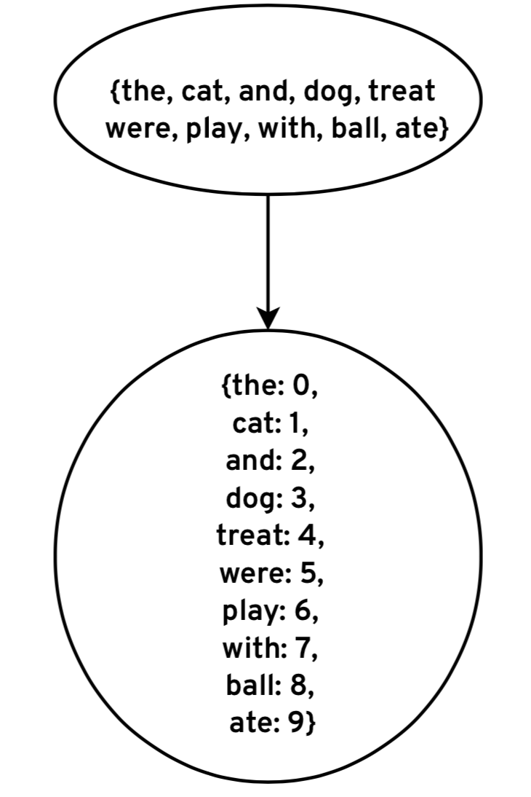
Map Words to Column Indices

Slide 38
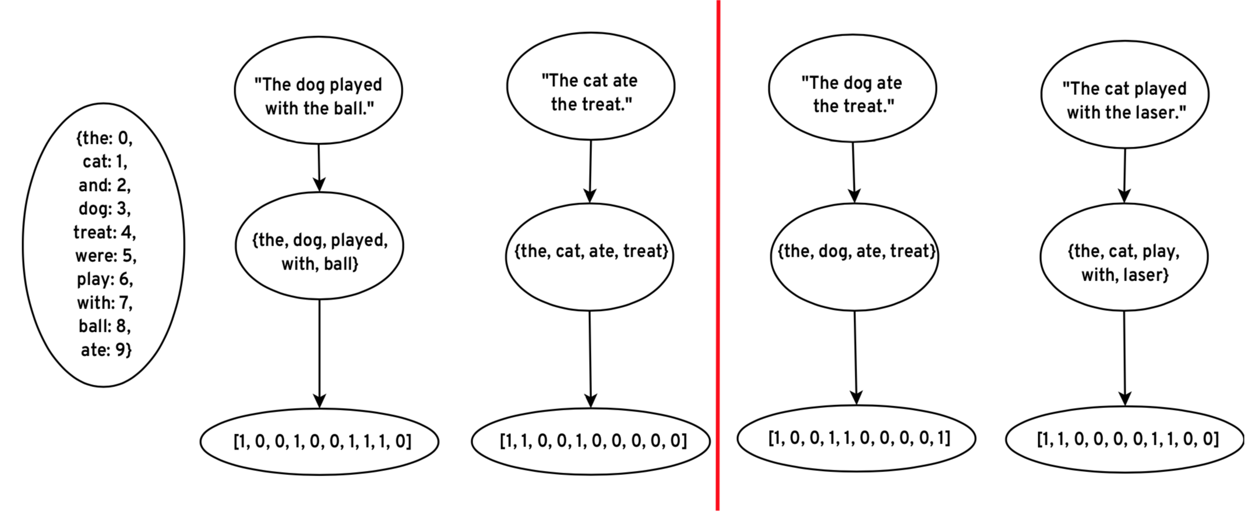
Encode Features

Slide 39
Encode Features

Slide 40
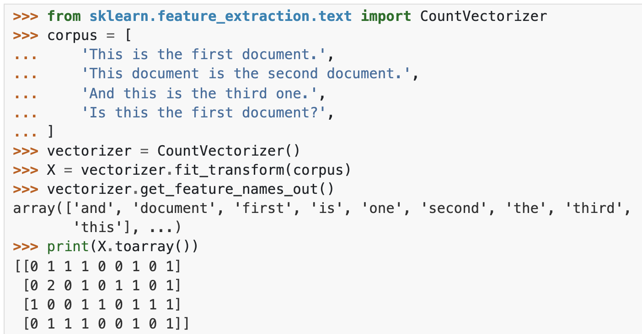
CountVectorizer

Slide 41
Missing Data and Imputation
This is where we deal with missing data
For numerical features, missing data is represented as NaNs
Software will crash when you attempt to do math with NaNs
For categorical features, all dummies are 0 – no problems
We have to maintain our experimental setup:
Training the imputer on training set records with known values
Impute the missing values in the training and testing sets with that average value

Slide 42
Imputation: Mean or Mode
A simple imputation strategy
Calculate the mean, median, or mode of known values
Replace missing values with calculated value
Tends to be safe in that imputed values will not bias ML models
Most common practice
May not be appropriate:
e.g., using an average birth year for for historical figures

Slide 43
SimpleImputer
from sklearn.preprocessing import SimpleImputer
imputer = simpleImputer()
train_df["my_column"] = imputer.fit_transform(train_df[["my_column"]])[:, 0]
test_df["my_column"] = imputer.transform(test_df[["my_column"]]) [:, 0]

Slide 44
Imputation: Nearest Neighbor
More complex strategy
Find similar records using other fields with known values
Use known values from similar records to impute missing value
Not many good (robust) implementations available
May fail when a large number of records have missing values
Complex
Requires transforming data (feature engineering, scaling) to work well
Basically doing machine learning at that point

Slide 45
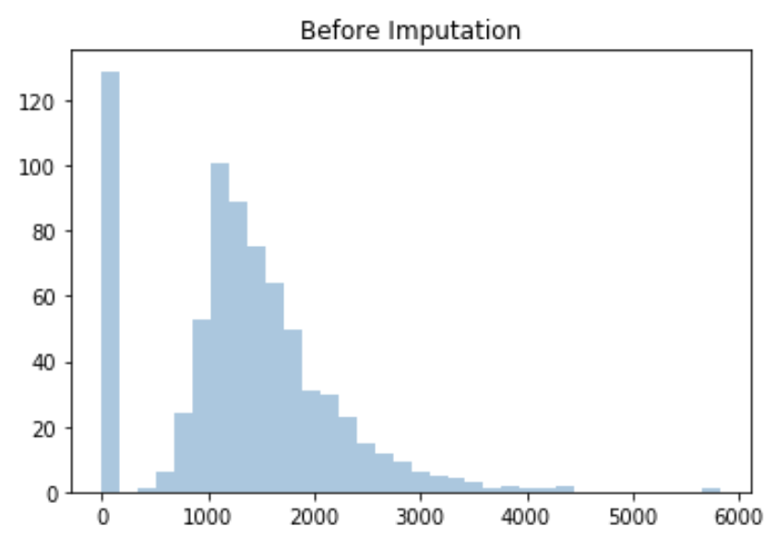
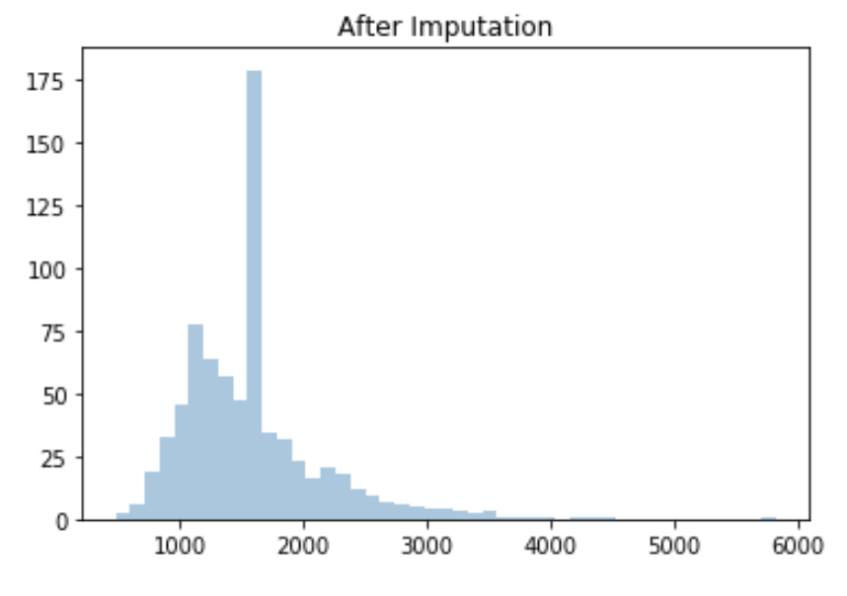
Imputing Square Footage

Slide 46
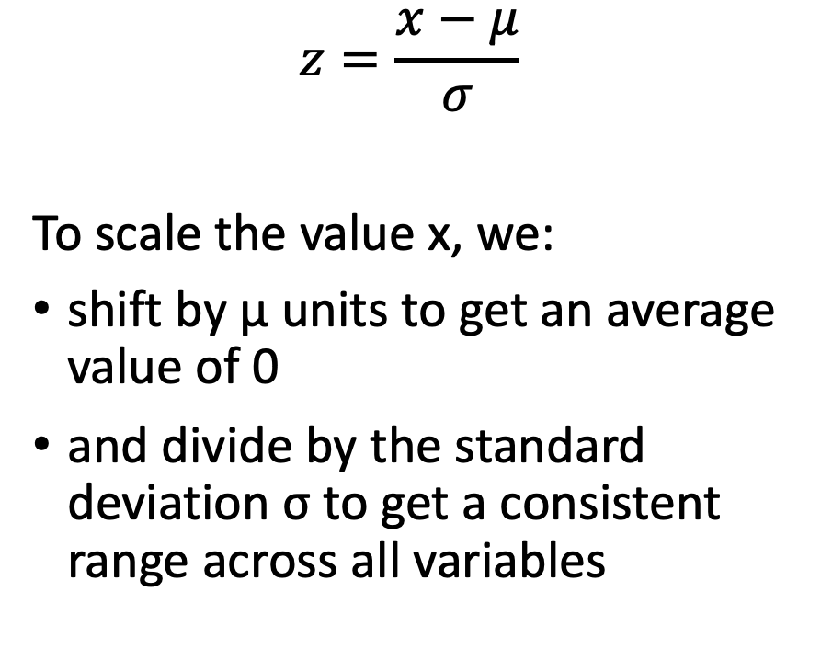
Scaling
Many machine learning algorithms do better when variables have:
the same ranges
an average value of 0
We can scale the values of the variables without changing their overall distribution
$$z=\frac{x−μ}{σ}$$
To scale the value x, we:
shift by μ units to get an average value of 0
and divide by the standard deviation σ to get a consistent range across all variables

Slide 47
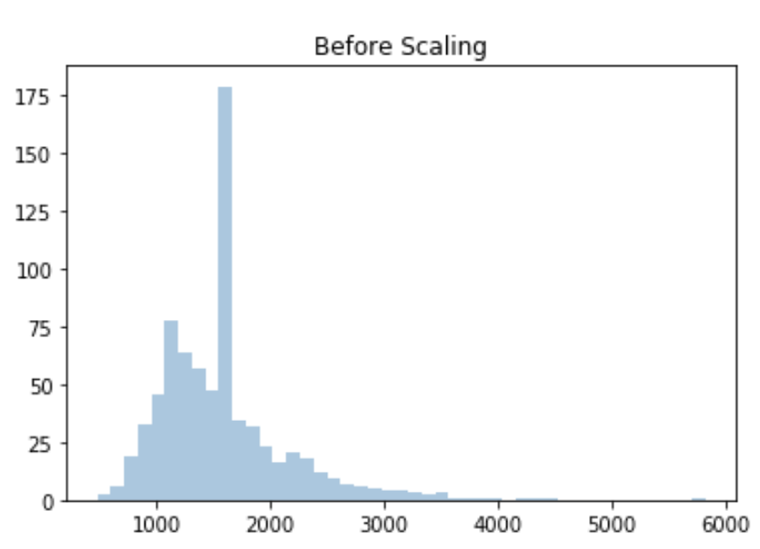
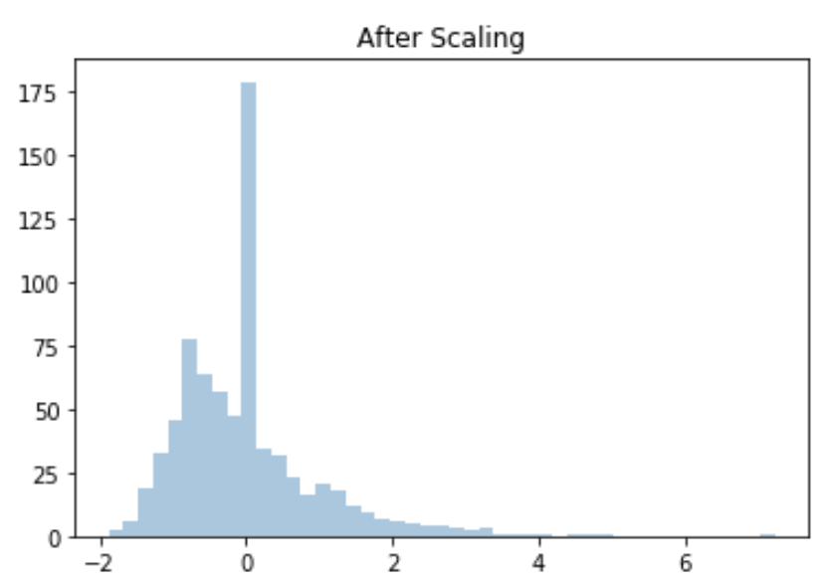
Scaling Square Footage

Slide 48
Scaling
from sklearn.preprocessing import StandardScaler
scaler = StandardScaler()
scaled_train_X = scaler.fit_transform(train_df.values)
scaled_test_X = scaler.transform(test_df.values)

Slide 49
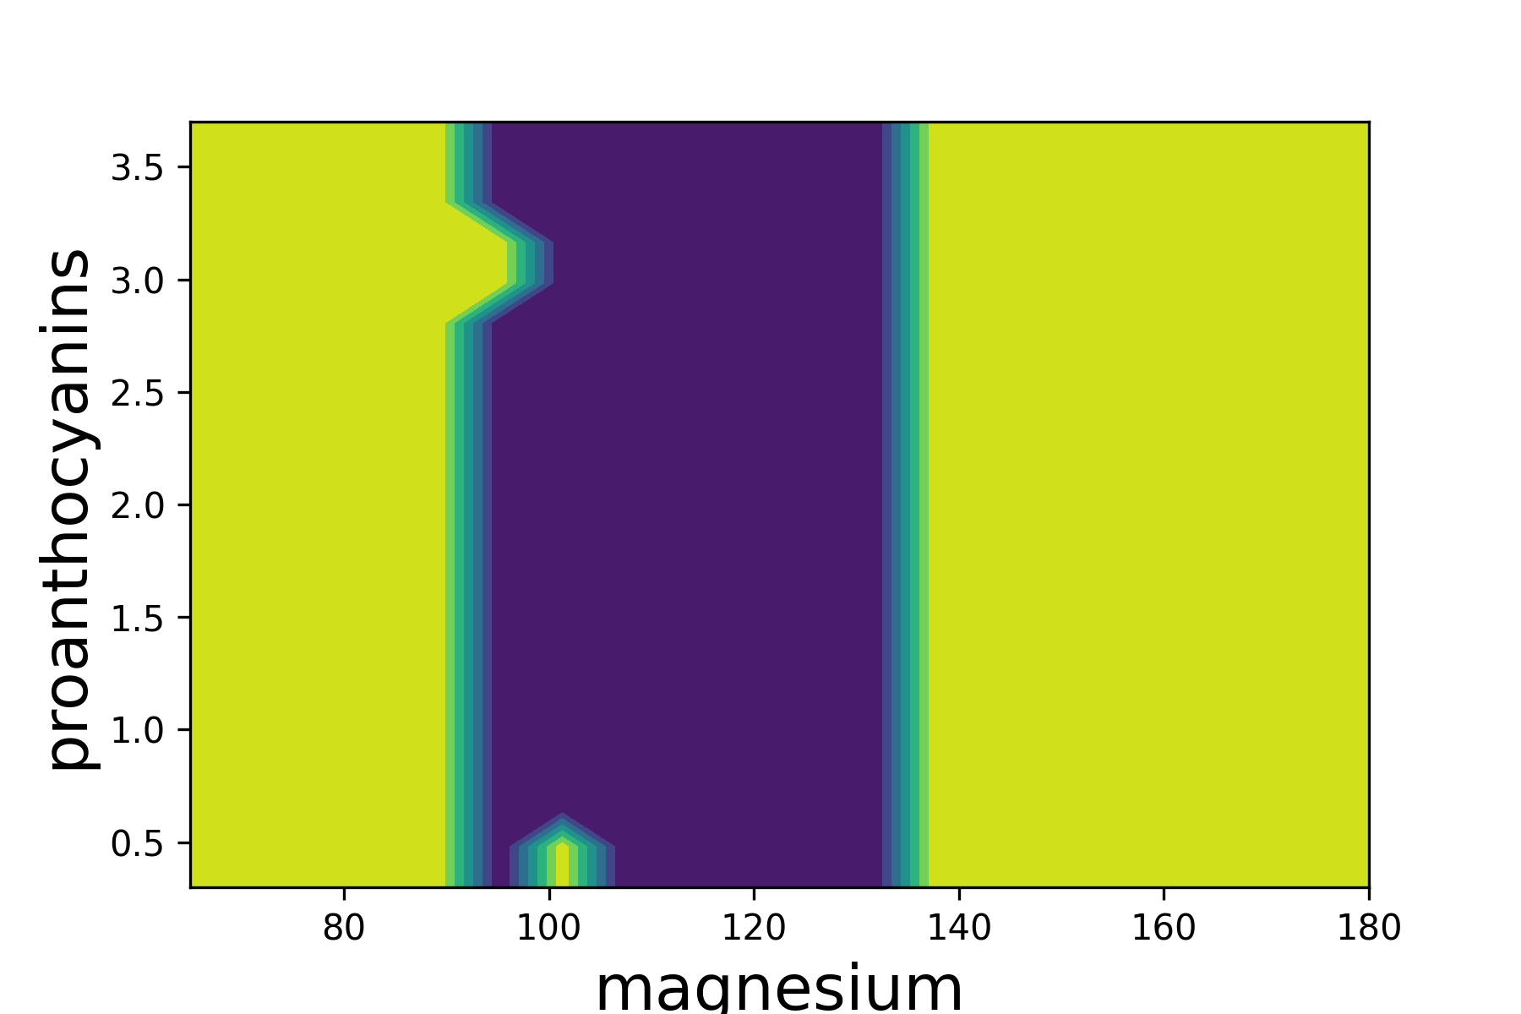
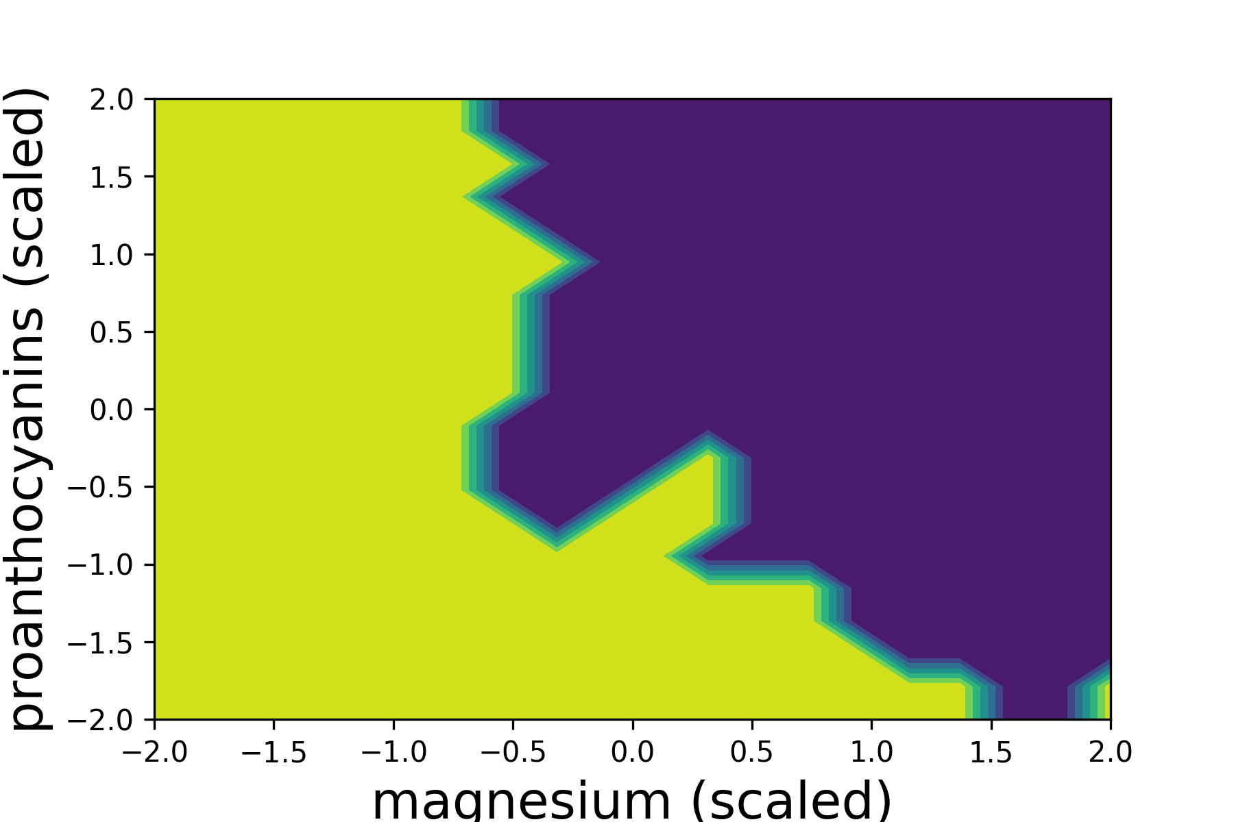
Feature Scaling

Slide 50
Model Development
Source: https://www.phdata.io/blog/mlops-vs-devops-whats-the-difference/

Slide 51
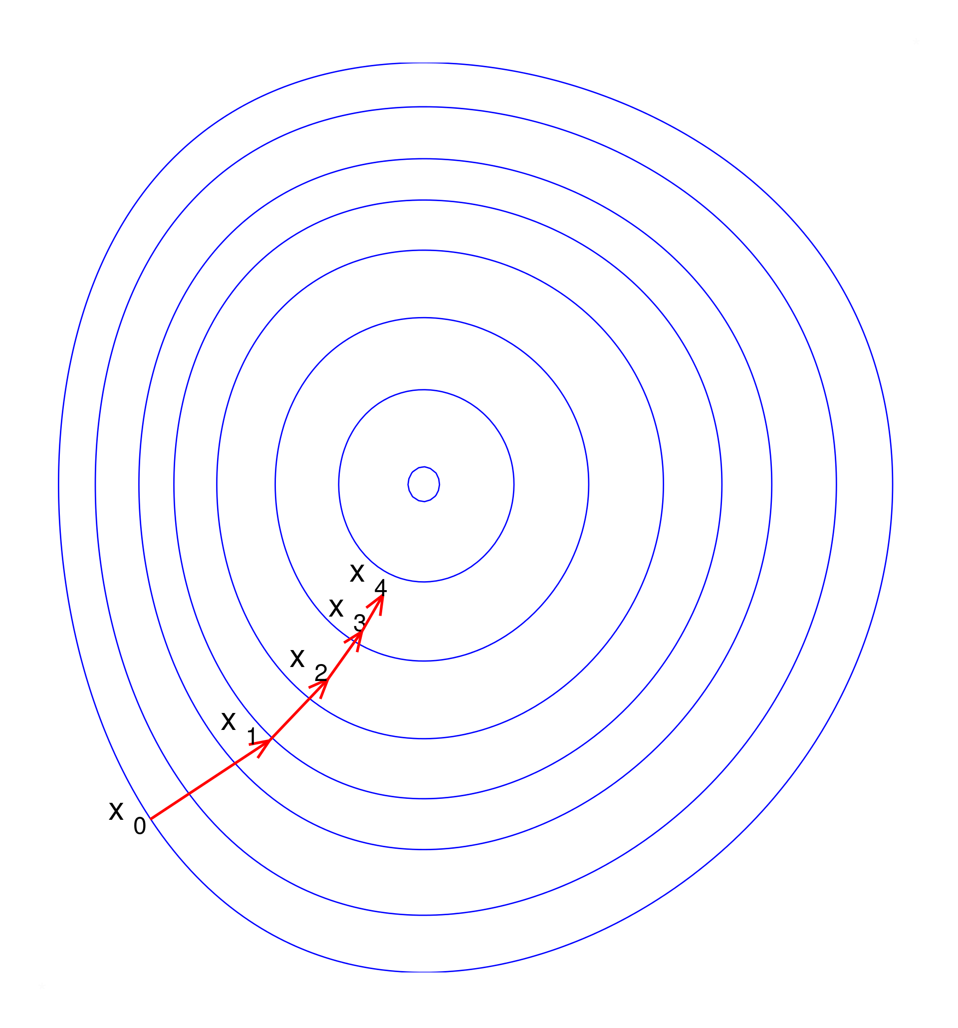
Hyper-Parameter Tuning
Iterations of the optimizer
Number of trees
Regularization (L₁ or L₂)
Number of layers, neurons per layer

Slide 52

Cross-fold Validation
Cross-fold validation is a more sophisticated approach to train-test splitting
Instead of generating one split, the data is divided into multiple "folds"
Each datum is assigned to a single fold
You then loop through the folds, using each fold as the hold out set. You train on the remaining folds and evaluate the on the hold out set.

Slide 53
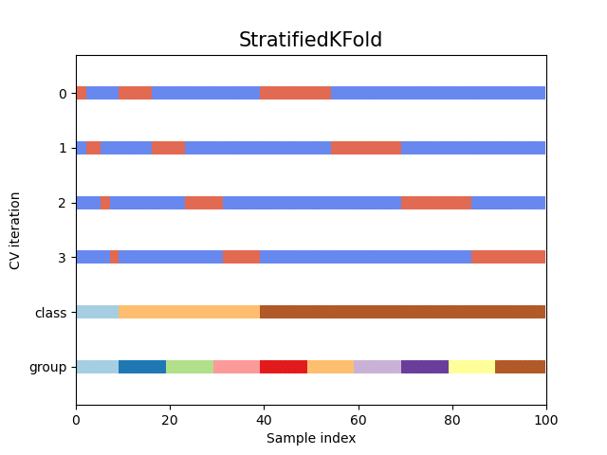
StratifiedKFold
We first stratify by class
Each class is divided into k-folds
The k-folds are then merged
We loop over each fold, using it as the hold out set for testing

Slide 54
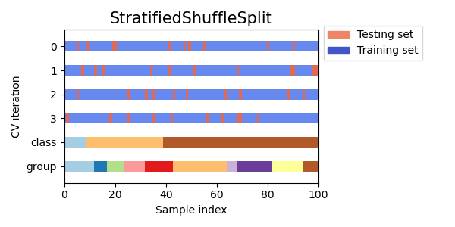
Cross-fold Validation with Stratification for Classification
skf = StratifiedKFold(shuffle=True)
for train_index, test_index in
skf.split(features, labels):
train_features, test_features =
features[train_idx],
features[test_index]

Slide 55
Model Development
Source: https://www.phdata.io/blog/mlops-vs-devops-whats-the-difference/

Slide 56
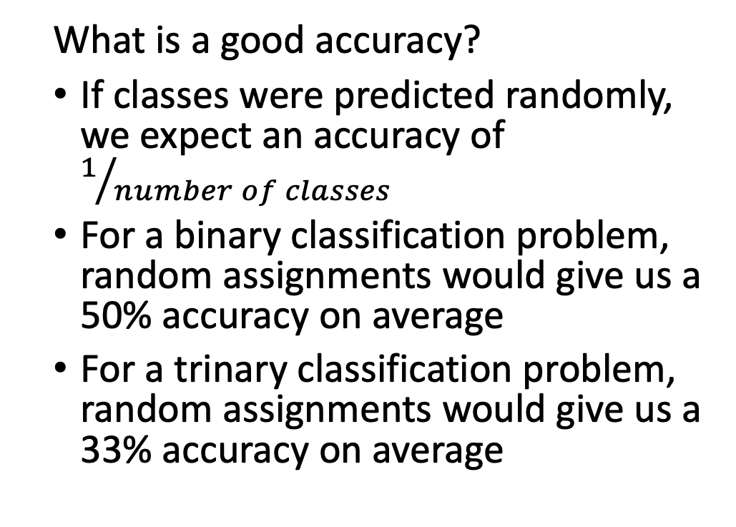
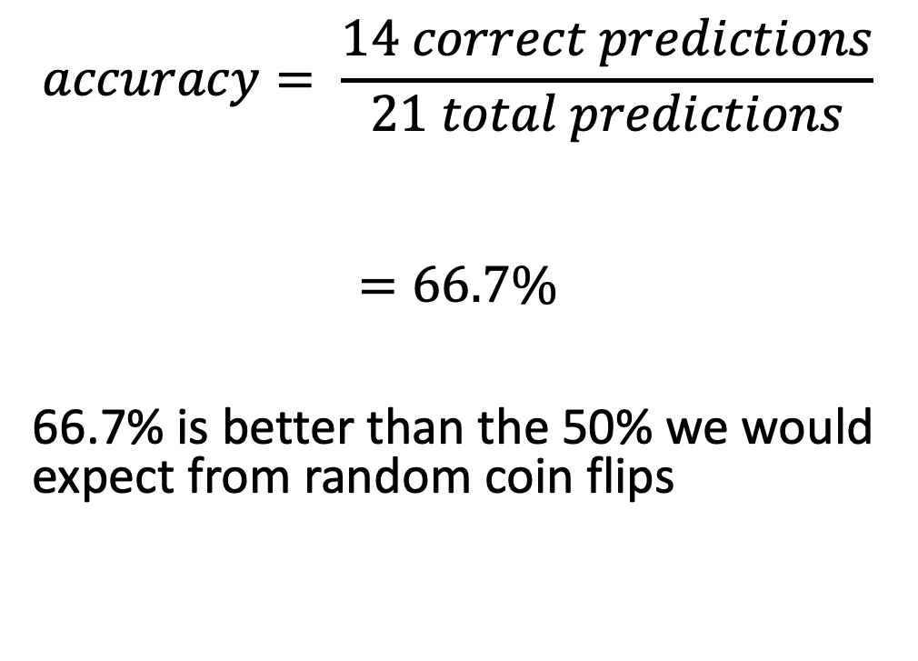
Accuracy
What is a good accuracy?
If classes were predicted randomly, we expect an accuracy of $1/{number of classes}$
For a binary classification problem, random assignments would give us a 50% accuracy on average
For a trinary classification problem, random assignments would give us a 33% accuracy on average
$$accuracy= \frac{14 correct predictions}{21 total predictions}$$
$$=66.7\%$$
66.7% is better than the 50% we would expect from random coin flips

Slide 57
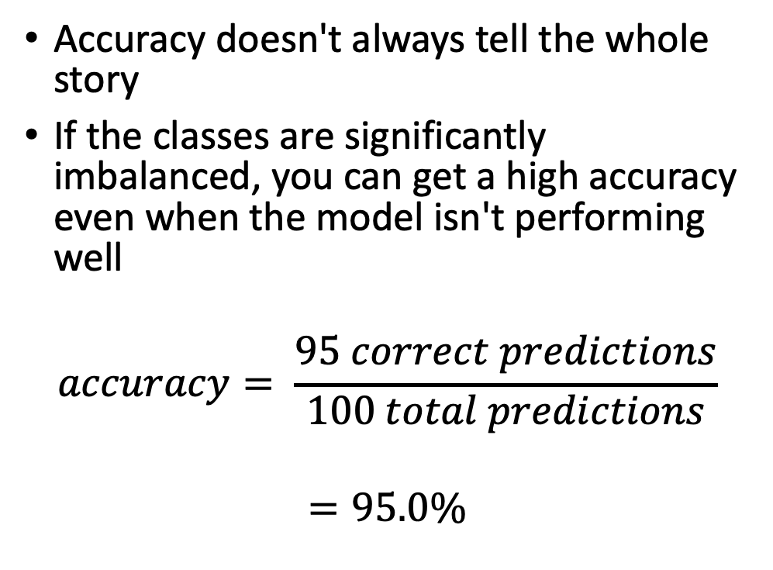
Class Imbalance
 |  | Predicted Labels
 |  | Cat | Dog
True Labels | Cat | 95 | 0
 | Dog | 5 | 0
Accuracy doesn't always tell the whole story
If the classes are significantly imbalanced, you can get a high accuracy even when the model isn't performing well
$$accuracy= \frac{95 correct predictions}{100 total predictions}$$
$$=95.0\%$$

Slide 58
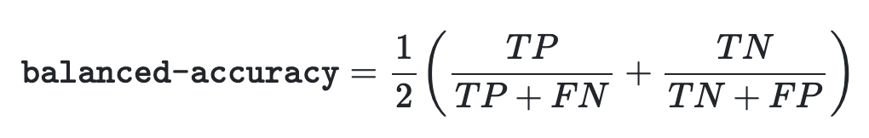
Metrics for Imbalance
Balanced accuracy
Recall / Precision
ROC curves and area under the curve

Slide 59
Recall and Precision
 |  | Predicted Labels
 |  | Cat | Dog
True Labels | Cat | 7 | 3
 | Dog | 4 | 7
Recall and precision tell us the performance for a single class
The chosen class is known as the positive class, while the other classes become the negatives
In this example, we'll define:
positive = dog
negative = cat

Slide 60
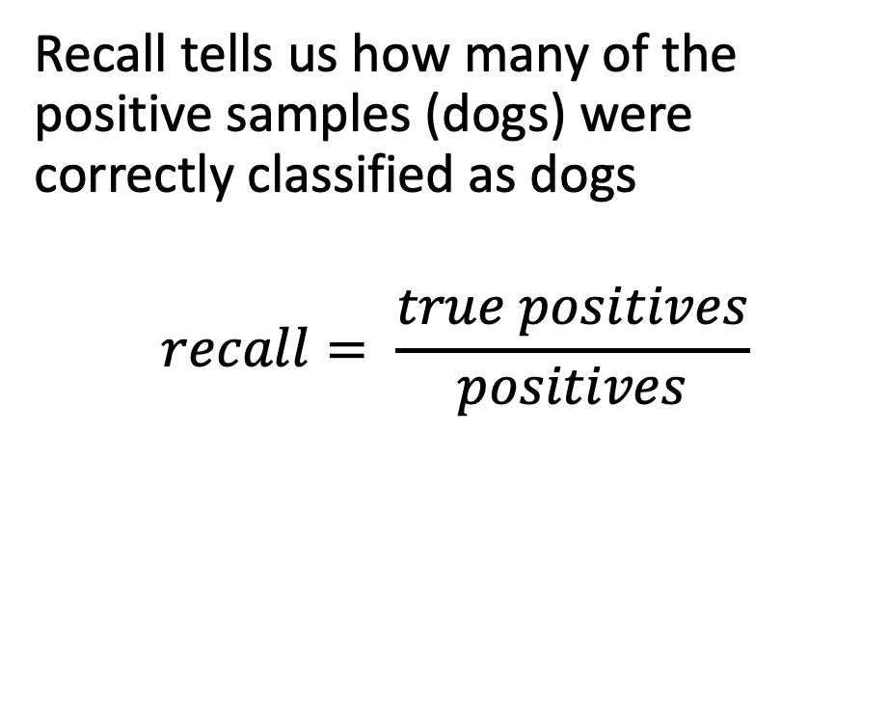
Recall
 |  | Predicted Labels
 |  | Cat | Dog
True Labels | Cat | 7 | 3
 | Dog | 4 | 7
Recall tells us how many of the positive samples (dogs) were correctly classified as dogs
$$recall= \frac{true positives}{positives}$$

Slide 61
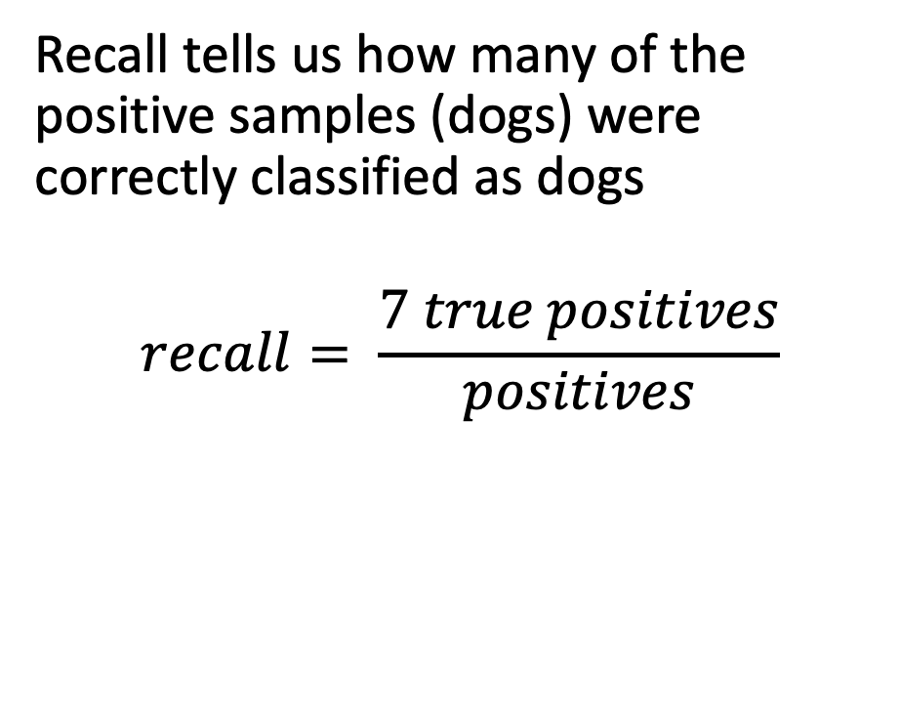
Recall
 |  | Predicted Labels
 |  | Cat | Dog
True Labels | Cat | 7 | 3
 | Dog | 4 | 7
Recall tells us how many of the positive samples (dogs) were correctly classified as dogs
$$recall= \frac{7 true positives}{positives}$$

Slide 62
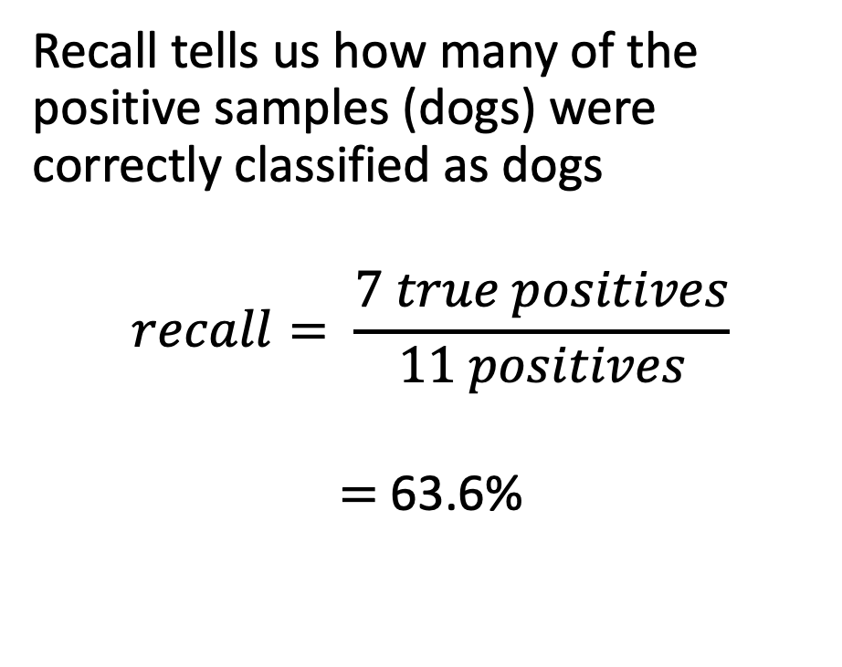
Recall
 |  | Predicted Labels
 |  | Cat | Dog
True Labels | Cat | 7 | 3
 | Dog | 4 | 7
Recall tells us how many of the positive samples (dogs) were correctly classified as dogs
$$recall= \frac{7 true positives}{11 positives}$$
$=$63.6%

Slide 63
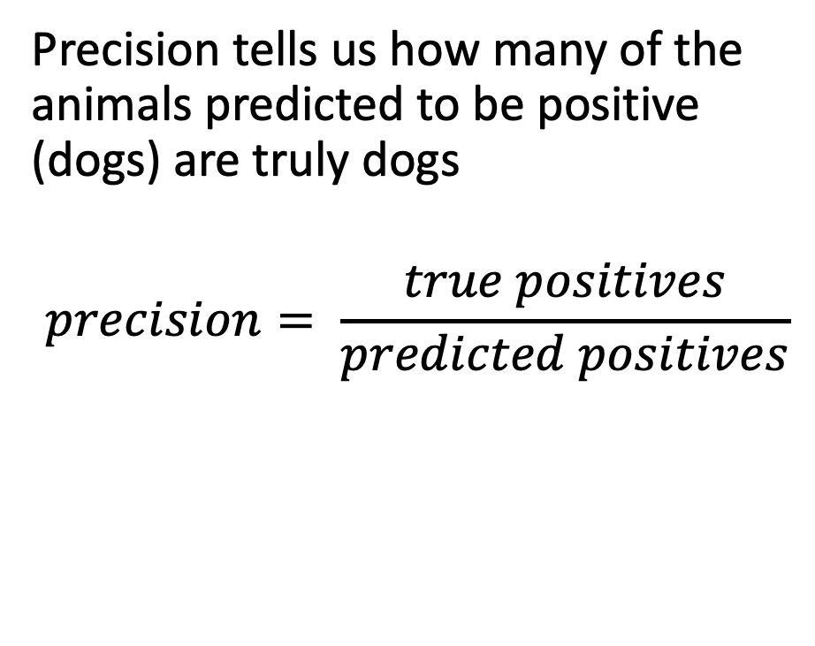
Precision
 |  | Predicted Labels
 |  | Cat | Dog
True Labels | Cat | 7 | 3
 | Dog | 4 | 7
Precision tells us how many of the animals predicted to be positive (dogs) are truly dogs
$$precision= \frac{true positives}{predicted positives}$$

Slide 64
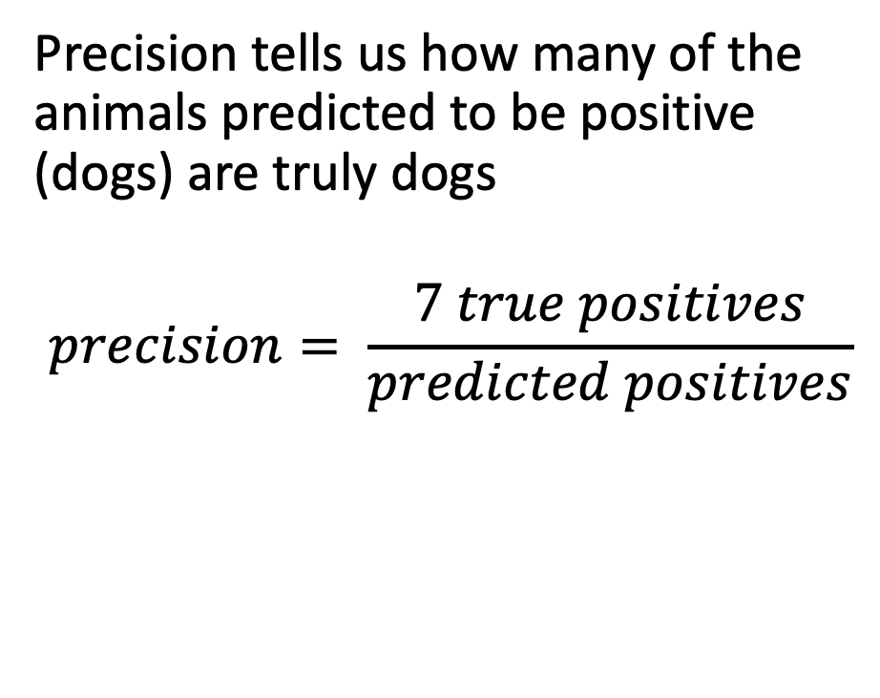
Precision
 |  | Predicted Labels
 |  | Cat | Dog
True Labels | Cat | 7 | 3
 | Dog | 4 | 7
Precision tells us how many of the animals predicted to be positive (dogs) are truly dogs
$$precision= \frac{7 true positives}{predicted positives}$$

Slide 65
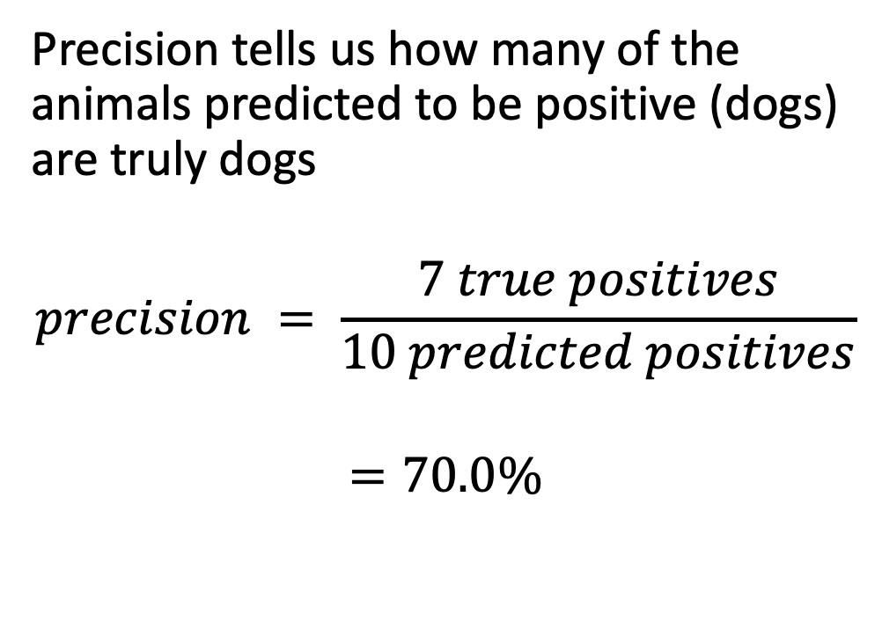
Precision
 |  | Predicted Labels
 |  | Cat | Dog
True Labels | Cat | 7 | 3
 | Dog | 4 | 7
Precision tells us how many of the animals predicted to be positive (dogs) are truly dogs
$$precision = \frac{7 true positives}{10 predicted positives}$$
$$=70.0\%$$

Slide 66
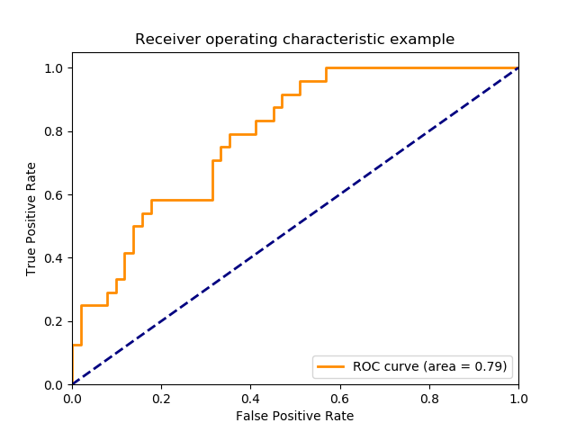
Receiver-Operator Characteristics (ROC) Curve
ROC curves tell us evaluate the trade off between true positive rate (sensitivity) and false positive rate (specificity)
Good classifiers have lines near the upper left
A random classifier produces a diagonal line
ROC curves can help us choose a threshold other the default 0.5

Slide 67

ROC Curve
To create a ROC curve, we need "scores" from the classifier
E.g., probabilities from logistic regression
For each sample, we store a triplet of (score, true label, predicted label)
We sort the samples' predictions by the scores

Slide 68
ROC Curve
We then define a sequence of thresholds for the scores
For each threshold, we calculate: fpr = f(predictions, threshold) tpr = f(predictions, threshold)
We plot the fpr, tpr outputs for each threshold to get the ROC curve

Slide 69
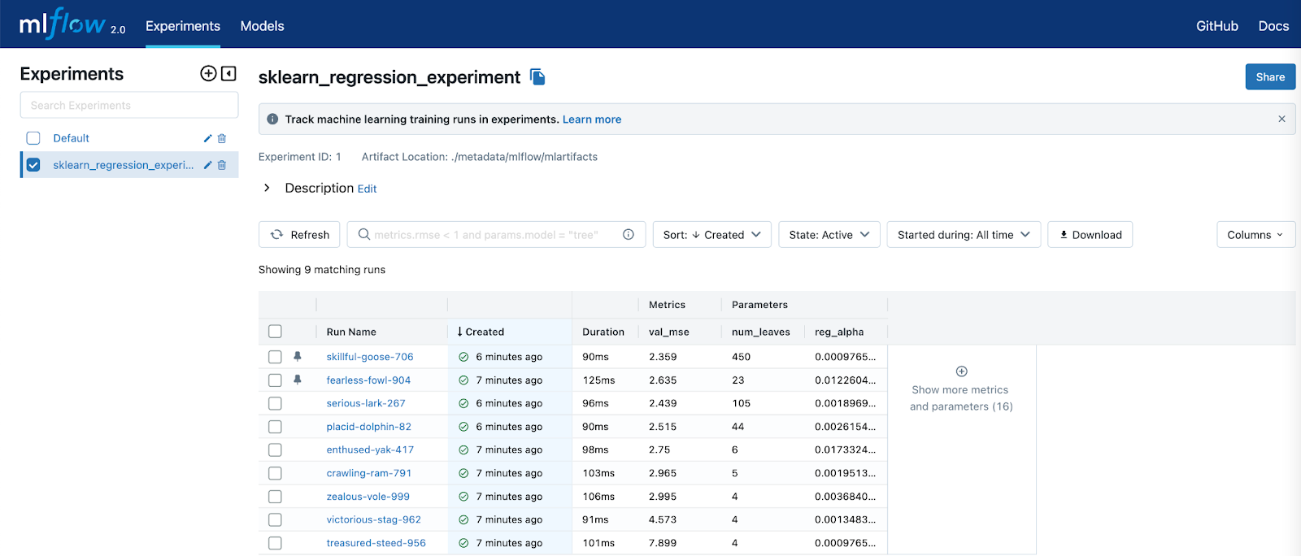
Experiment Tracking
Frameworks such as MLflow allow you to track experiments
They record metadata about the training / testing data (time ranges), models used, hyper-parameters selected, feature transformations, and the metrics from the evaluation
Can be used to organize large numbers of experiments and reproduce results
Source: https://www.linuxfoundation.org/blog/announcing-availability-of-mlflow-2.0

